Slide 1
UPPER SIXTH ARTS
GEOGRAPHY
Practical Work 2
Delimiting Urban Fields
Notes:
Good morning, class, and welcome to our geography lesson. I am your geography teacher, Mr Kamdem. Today we are starting Practical Work 2: Delimiting Urban Fields.

Slide 2
CLASS INFO
Class, Chapter and Duration
Class | Upper Sixth Arts
Chapter | Module 5: Understanding and managing settlement dynamics across the world in general and Cameroon in particular
Duration | 2 periods (2 × 50 minutes)
Notes:
This lesson is for Upper Sixth Arts. It belongs to Module 5: Understanding and managing settlement dynamics across the world in general and Cameroon in particular. We shall need 2 periods to cover it.

Slide 3
IDENTIFICATION
Lesson Identification
Topic | Urban Hierarchy
Sub-topic | Urban Growth
Lesson | Practical Work 2: Delimiting Urban Fields
Notions / Concepts | Urban field, criteria, questionnaire, bus services, Reilly's law, breaking point.
Syllabus focus | Criteria for determining urban fields; calculation of boundaries with Reilly's breaking-point formula.
Competence | Learners are able to delimit urban fields using criteria and Reilly's formula.
Notes:
Our topic is Urban Hierarchy, and the sub-topic is Urban Growth. The key notions we shall use today are: urban field, criteria, questionnaire, bus services, Reilly's law, breaking point. At the end, you should be able to do this: learners are able to delimit urban fields using criteria and Reilly's formula.

Slide 4

HOMEWORK CORRECTION
Correction of the Homework
Question (Lesson 14: Urban Fields (Spheres of Influence)):
Ask 10 people where they go for a market, a bank and a hospital. Draw the fields.
Notes:
Before we start the new lesson, let us correct the homework I gave you at the end of Lesson 14: Urban Fields (Spheres of Influence). The question was: Ask 10 people where they go for a market, a bank and a hospital. Draw the fields. Take out your exercise books.

Slide 5
HOMEWORK CORRECTION
Correction: Possible Answer
Example: for the market people come from 5–10 km, for the bank from 20–30 km and for the regional hospital from over 50 km. The fields are drawn as zones of different sizes around the town.
Notes:
Here is a good answer. Example: for the market people come from 5–10 km, for the bank from 20–30 km and for the regional hospital from over 50 km. The fields are drawn as zones of different sizes around the town. Compare it with your own answer and correct your work in red.

Slide 6
LESSON PLAN
Lesson Plan
Correction of the homework
Objectives and recall
Real-life situation and action to take
Learning activities
Board summary
Evaluation, remediation and homework
Notes:
Here is the plan of our lesson today. First, we shall correct the homework. Then we shall look at the objectives and recall what you already know. After that, we shall study a situation from real life and the action to take, and do the learning activities. Finally, we shall copy the board summary, do the evaluation and the remediation, and I will give you the homework.

Slide 7
OBJECTIVES
Objectives
By the end of this lesson, you should be able to:
List criteria used to delimit urban fields.
Apply Reilly's formula.
Draw and interpret urban field boundaries.
Notes:
By the end of this lesson, you should be able to do three things. Number 1: list criteria used to delimit urban fields. Number 2: apply Reilly's formula. Number 3: draw and interpret urban field boundaries.

Slide 8
PREVIOUS KNOWLEDGE
Previous Knowledge
Urban fields depend on size and transport.
The breaking point is closer to the smaller town.
Notes:
Let us first remember what you already know. Urban fields depend on size and transport. The breaking point is closer to the smaller town. Keep this in mind, because we shall build on it today.

Slide 9
REAL-LIFE SITUATION
Situation in Real Life
The council of a town wants to know which villages use its market and hospital, and where its influence ends compared with a larger town 90 km away.
Notes:
Listen carefully to this situation from real life. The council of a town wants to know which villages use its market and hospital, and where its influence ends compared with a larger town 90 km away. Think about it, because I am going to ask you some questions.

Slide 10
REAL-LIFE SITUATION
Situation: Question 1
What is the problem in the situation?
Notes:
Question 1: What is the problem in the situation? Think for a moment, then raise your hand to answer.

Slide 11
REAL-LIFE SITUATION
Answer
The council must find the limit of its town's influence.
Notes:
Good. The council must find the limit of its town's influence.

Slide 12
REAL-LIFE SITUATION
Situation: Question 2
Name one way to collect data.
Notes:
Question 2: Name one way to collect data. Think for a moment, then raise your hand to answer.

Slide 13
REAL-LIFE SITUATION
Answer
A questionnaire to customers or bus timetables.
Notes:
Good. A questionnaire to customers or bus timetables.

Slide 14
REAL-LIFE SITUATION
Situation: Question 3
What formula finds the boundary?
Notes:
Question 3: What formula finds the boundary? Think for a moment, then raise your hand to answer.

Slide 15
REAL-LIFE SITUATION
Possible Answer
Reilly's law of retail gravitation.
Notes:
Good. Reilly's law of retail gravitation.

Slide 16
ACTION TO TAKE
Action to Take
Delimit urban fields using data and Reilly's law.
Notes:
From this situation, the action we are working towards in this lesson is the following: delimit urban fields using data and Reilly's law.

Slide 17
JUSTIFICATION
Justification of the Lesson
This practical work helps us to measure the influence of towns.
Notes:
Why is this lesson important for you? This practical work helps us to measure the influence of towns.

Slide 18
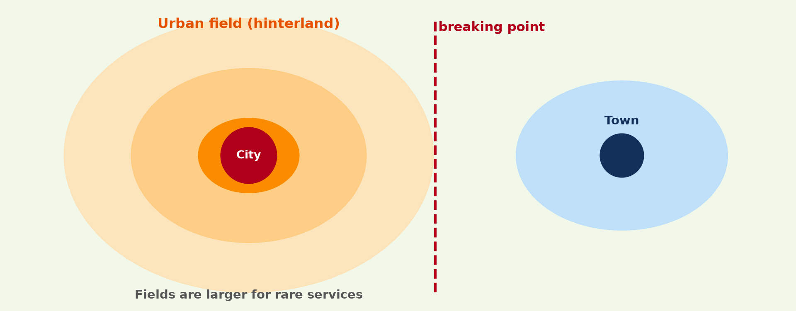
1. CRITERIA
Activity 1
An urban field.
Notes:
Activity 1. Look carefully at this diagram: an urban field. Observe every detail before I ask the question.

Slide 19
1. CRITERIA
Activity 1: Question
Give three criteria used to delimit an urban field.
Notes:
Here is the question for Activity 1: Give three criteria used to delimit an urban field. Take one minute to think and write your answer in your rough notebook.

Slide 20
1. CRITERIA
Activity 1: Answer
Where shoppers, workers and pupils come from (also bus routes, newspapers, hospitals).
Notes:
Let us check the answer together. Where shoppers, workers and pupils come from (also bus routes, newspapers, hospitals).

Slide 21

2. DATA COLLECTION
Activity 2
A market.
Notes:
Activity 2. Look carefully at this picture: a market. Observe every detail before I ask the question.

Slide 22
2. DATA COLLECTION
Activity 2: Question
How can a questionnaire help to delimit a field?
Notes:
Here is the question for Activity 2: How can a questionnaire help to delimit a field? Take one minute to think and write your answer in your rough notebook.

Slide 23
2. DATA COLLECTION
Activity 2: Answer
It shows where customers come from.
Notes:
Let us check the answer together. It shows where customers come from.

Slide 24
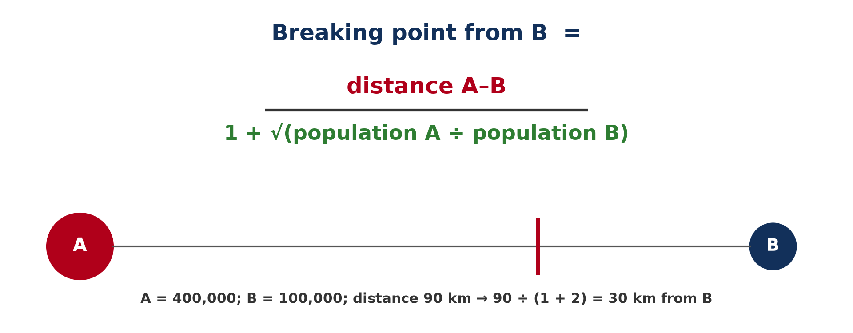
3. REILLY'S LAW
Activity 3
Reilly's breaking-point formula.
Notes:
Activity 3. Look carefully at this diagram: reilly's breaking-point formula. Observe every detail before I ask the question.

Slide 25
3. REILLY'S LAW
Activity 3: Question
Town A has 400,000 people, B 100,000, and they are 90 km apart. Where is the breaking point?
Notes:
Here is the question for Activity 3: Town A has 400,000 people, B 100,000, and they are 90 km apart. Where is the breaking point? Take one minute to think and write your answer in your rough notebook.

Slide 26
3. REILLY'S LAW
Activity 3: Answer
90 ÷ (1 + √4) = 30 km from B.
Notes:
Let us check the answer together. 90 ÷ (1 + √4) = 30 km from B.

Slide 27

3. REILLY'S LAW
Activity 4
Main towns of Cameroon.
Notes:
Activity 4. Look carefully at this diagram: main towns of Cameroon. Observe every detail before I ask the question.

Slide 28
3. REILLY'S LAW
Activity 4: Question
Yaoundé 4.3 M, Bafia 0.1 M, 120 km apart. Find the breaking point from Bafia.
Notes:
Here is the question for Activity 4: Yaoundé 4.3 M, Bafia 0.1 M, 120 km apart. Find the breaking point from Bafia. Take one minute to think and write your answer in your rough notebook.

Slide 29
3. REILLY'S LAW
Activity 4: Answer
120 ÷ (1 + √43) ≈ 120 ÷ 7.6 ≈ 16 km from Bafia.
Notes:
Let us check the answer together. 120 ÷ (1 + √43) ≈ 120 ÷ 7.6 ≈ 16 km from Bafia.

Slide 30

4. LIMITS
Activity 5
Road transport.
Notes:
Activity 5. Look carefully at this picture: road transport. Observe every detail before I ask the question.

Slide 31
4. LIMITS
Activity 5: Question
Give one limit of Reilly's formula.
Notes:
Here is the question for Activity 5: Give one limit of Reilly's formula. Take one minute to think and write your answer in your rough notebook.

Slide 32
4. LIMITS
Activity 5: Answer
It ignores road quality, prices and people's choices.
Notes:
Let us check the answer together. It ignores road quality, prices and people's choices.

Slide 33
BOARD SUMMARY
Board Summary
Topic: Urban Hierarchy
Sub-topic: Urban Growth
Practical Work 2: Delimiting Urban Fields
Notes:
Now we are going to copy the board summary. Write the title and the headings neatly in your notebooks. I will give you enough time for each slide, so do not rush.

Slide 34
BOARD SUMMARY
DEFINITIONS
The key terms of this lesson are defined as follows:
Breaking point: It is the point between two towns where their influence is equal.
Notes:
Let us copy the definitions. The key terms of this lesson are defined as follows. On this slide we have Breaking point. Write each point on a new line, with the key term first, and explain it in your own words when we revise.

Slide 35
BOARD SUMMARY
1. Methods of Delimiting Urban Fields
Urban fields are delimited as follows:
Criteria: Use the areas served by newspapers, buses, schools, hospitals, markets and shops. Each criterion gives a line; together they show the field.
Notes:
Let us copy Methods of Delimiting Urban Fields. Urban fields are delimited as follows. On this slide we have Criteria. Write each point on a new line, with the key term first, and explain it in your own words when we revise. When you finish, we go to the next slide.

Slide 36
BOARD SUMMARY
1. Methods of Delimiting Urban Fields (continued)
Data collection: Questionnaires ask people where they shop, study or seek health care. The answers are mapped with desire lines.
Notes:
We continue with Methods of Delimiting Urban Fields. On this slide we have Data collection. Write each point on a new line, with the key term first, and explain it in your own words when we revise.

Slide 37
BOARD SUMMARY
2. Reilly's Law of Retail Gravitation
The breaking point is calculated as follows:
Formula: Distance of the breaking point from the smaller town B = d ÷ (1 + √(PA ÷ PB)). d is the distance between the towns, PA and PB their populations.
Notes:
Let us copy Reilly's Law of Retail Gravitation. The breaking point is calculated as follows. On this slide we have Formula. Write each point on a new line, with the key term first, and explain it in your own words when we revise. When you finish, we go to the next slide.

Slide 38
BOARD SUMMARY
2. Reilly's Law of Retail Gravitation (continued)
Example: A = 400,000, B = 100,000, d = 90 km: 90 ÷ (1 + √4) = 90 ÷ 3 = 30 km from B. The field of the larger town is bigger.
Limits: The formula assumes equal transport and services and ignores people's preferences. Real fields depend also on roads and prices.
Notes:
We continue with Reilly's Law of Retail Gravitation. On this slide we have Example and Limits. Write each point on a new line, with the key term first, and explain it in your own words when we revise.

Slide 39
BOARD SUMMARY
2. Reilly's Law of Retail Gravitation
Illustration: Reilly's breaking point
Notes:
Now draw this illustration in your notebook: reilly's breaking point. Give it a title and label it clearly.

Slide 40
FORMATIVE EVALUATION
Evaluation 1
A: 900,000; B: 100,000; distance 80 km. Find the breaking point from B.
Notes:
Now let us check what you have understood. Question 1: A: 900,000; B: 100,000; distance 80 km. Find the breaking point from B. Answer in your exercise book.

Slide 41
FORMATIVE EVALUATION
Expected Answer
80 ÷ (1 + √9) = 80 ÷ 4 = 20 km from B.
Notes:
The expected answer is: 80 ÷ (1 + √9) = 80 ÷ 4 = 20 km from B. If you got it right, well done.

Slide 42
FORMATIVE EVALUATION
Evaluation 2
Give two criteria for delimiting an urban field.
Notes:
Now let us check what you have understood. Question 2: Give two criteria for delimiting an urban field. Answer in your exercise book.

Slide 43
FORMATIVE EVALUATION
Expected Answer
Origin of shoppers and bus routes (also workers, pupils, patients).
Notes:
The expected answer is: origin of shoppers and bus routes (also workers, pupils, patients). If you got it right, well done.

Slide 44
REMEDIATION
Remediation
Fill in the blanks:
Reilly's law finds the ______ point.
The breaking point is closer to the ______ town.
Fieldwork uses ______ to find customers' origin.
Notes:
For those who need more practice, fill in the blanks in your exercise book. The answers are: number 1, breaking; number 2, smaller; number 3, questionnaires.

Slide 45
HOMEWORK
Homework
Calculate the breaking point between your town and the nearest larger town.
Notes:
For your homework: Calculate the breaking point between your town and the nearest larger town. We shall correct it at the beginning of our next lesson.

Slide 46
NEXT LESSON
Next Lesson
Our next lesson will be on:
Lesson 15: Urban Hierarchy and Central Place Theory
Notes:
Our next lesson will be on Lesson 15: Urban Hierarchy and Central Place Theory. Thank you for your attention, and see you next time.

Slide 47
BILINGUAL GAME
Bilingual Game (Jeu Bilingue)
English | Français
Questionnaire | Le questionnaire
Boundary | La limite
Formula | La formule
Shopper | L'acheteur
Bus route | La ligne d'autobus
Fieldwork | Le travail de terrain
Notes:
Let us play the bilingual game. I say a word in English, and you give me the French word. Then we do the reverse.

Slide 48
LOGBOOK
Official Logbook (1/2)
Module / Topic | Urban Hierarchy
Lesson Title | Practical Work 2: Delimiting Urban Fields
Expected Learning Outcomes | List criteria used to delimit urban fields. Apply Reilly's formula. Draw and interpret urban field boundaries.
Competence | Learners are able to delimit urban fields using criteria and Reilly's formula.
Notes:
I record this information in the official logbook of the class after the lesson.

Slide 49
LOGBOOK
Official Logbook (2/2)
Matter Taught | DEFINITIONS; Methods of Delimiting Urban Fields; Reilly's Law of Retail Gravitation.
Evaluation | Formative evaluation and remediation exercise.
Homework | Calculate the breaking point between your town and the nearest larger town.
Enrolment / Present / Absent | ____ / ____ / ____
Achievement | To be completed after the lesson.
Notes:
I complete the second page of the logbook: the matter taught, the evaluation, the homework and the attendance.

Slide 50
TEACHER'S NOTE
Teacher's Note
Timing: Homework correction, plan, objectives 8 min | Recall, situation, action 10 min | 5 activities 30 min | Board summary (copying) 30 min | Evaluation, remediation 10 min | Homework, next lesson 5 min | Logbook 7 min
Without the projector (Activity 1): list criteria.
Without the projector (Activity 2): write three questions.
Without the projector (Activity 3): do the calculation.
Without the projector (Activity 4): find the towns.
Without the projector (Activity 5): discuss limits.
Notes:
This slide is for me, the teacher: it gives the timing of the lesson and what to do if the projector is not available.

Slide 51
REFERENCES
References
National Geography Syllabus, MINESEC/IGE/IP-SS, 2019 — Module 5 (Settlement Geography).
Photo, Activity 2: “Sandga Market in Douala, Cameroon” by The Advocacy Project, CC BY-NC-SA 2.0, via Flickr (https://www.flickr.com/photos/42487558@N00/3636438732)
Photo, Activity 5: “Cameroon - UN Women's Gender Road Project” by UN Women Gallery, CC BY-NC-ND 2.0, via Flickr (https://www.flickr.com/photos/51431730@N04/47586053052)
Diagrams and animations: drawn for this lesson (Geography Department).
Notes:
These are the references and picture credits used to prepare this lesson.

